Slide 1
Unit 1.2 - Multimedia (Graphics & Sound)
Prepared by: Koh Kian Hua

Slide 2
Objectives
After completing this unit, students should be able to:
Understand how data for a bitmapped image are encoded
Perform calculations to estimate the file size for a bitmap image
Understand of the effects of changing elements of a bitmap image on the image quality and file size
Understanding of how data for a vector graphic are encoded
Justify the use of a bitmap image or a vector graphic for a given task
Understand how sound is represented and encoded
Understandthe impact of changing the sampling rate and resolution
Use terms: pixel, file header, image resolution, screen resolution, colour depth/bit depth
Use the terms: image resolution, colour depth/bit depth
Use the terms: drawing object, property, drawing list
Use the terms: sampling, sampling rate, sampling resolution, analogue and digital data

Slide 3


Multimedia (Graphics & Sound)
Bit-map images
Bit-map images (also known as raster graphics) are made up of pixels (picture elements)
The image is stored in a two-dimensional matrix of pixels.
Pixels can take different shapes, such as or
Example of bitmap editing software is Microsoft Paint

Slide 4

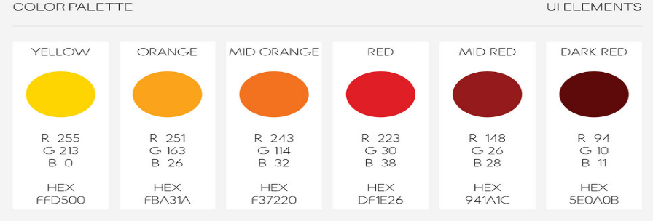
Multimedia (Graphics & Sound)
Bit-map images
Storing images as pixel requires consideration of the following:
  At least 8 bits (1 byte) per pixel (2⁸ = 256 colors) is required to code a coloured image (by varying the intensity of the blue, green and red elements)
  True colour requires 24 bits (2²⁴), which gives more than one million colours
  RGB Color Model

Slide 5
Multimedia (Graphics & Sound)
Bit-map images
Color depth: number of possible colors represented per pixel
Bit depth: the number of bits that are used to represent a single pixel
As the bit depth increases, the number of possible colours which can be represented also increases.
A bit depth of 8 bits per pixel allows 256 or 2⁸ different colours (the colour depth) to be represented.

Slide 6
Multimedia (Graphics & Sound)
Bit-map images
Important Definitions
Image resolution: the number of pixels that make up an image; eg, an image could contain 4096 × 3192 pixels (12 738 656 pixels in total).
Screen resolution: the number of horizontal pixels and the number of vertical pixels that make up a screen display
Note: If the screen resolution is smaller than the image resolution, the whole image cannot be shown on the screen or the original image will now be a lower quality.

Slide 7

Multimedia (Graphics & Sound)
Bit-map images
(Image Resolution Vs Screen Resolution)
Assuming the above image is taken by a digital camera using an image resolution of 4096 × 3192 pixels, the image would need to be re-sized using an image editing softtware to fit on a screen with screen solution of 1920 × 1080. A lower resolution copy of the above image would also fit on the screen without any modification to the image.

Slide 8
Multimedia (Graphics & Sound)
Bit-map images
Important Definitions
Pixel Density: the number of pixels per square inch
The higher the pixel density, the higher the image quality, and vice-versa

Slide 9
Multimedia (Graphics & Sound)
Bit-map images
Pixel Density: the number of pixels per square inch
Assuming an Apple iPhone 8 has:
a 5.5-inch screen size and
screen resolution of 1920 pixels × 1080 pixels:
To calculate pixel density:
1) Add together the squares of the resolution size:
1920² + 1080² = 3 686 400 + 16 640 = 4 852 800
2) Find the square root SQRT(4852800) = 2202.907
3) Divide by screen size (2202.907 ÷ 5.5 = 401) = 401 ppi (pixel density)

Slide 10
Multimedia (Graphics & Sound)
Bit-map images
Disadvantages of high-resolution images
large file-size due to high number of pixels
longer time to download from internet
smaller number of images can be stored (eg: on hard-drive)

Slide 11
Multimedia (Graphics & Sound)
Calculating Bit-map images file sizes
Estimate the file size needed to store a bit-map image with
a full screen resolution of 1920 × 1080 pixels and
a bit depth of 24
The bit-map image requires 1920 × 1080 × 24 bits
= 49 766 400 bits for the full screen image.
Since 1 byte = 8 bits, Dividing the result by 8 gives 6,220,800 bytes
(equivalent to 6.222 MB using the SI units or 5.933 MiB using IEE units)

Slide 12
Multimedia (Graphics & Sound)
Calculating Bit-map images file sizes
Estimate the file size needed to store a bit-map image with
a full screen resolution of 1920 × 1080 pixels and
a bit depth of 24
The bit-map image requires 1920 × 1080 × 24 bits
= 49 766 400 bits for the full screen image.
Since 1 byte = 8 bits, Dividing the result by 8 gives 6,220,800 bytes
(equivalent to 6.222 MB using the SI units or 5.933 MiB using IEE units)

Slide 13
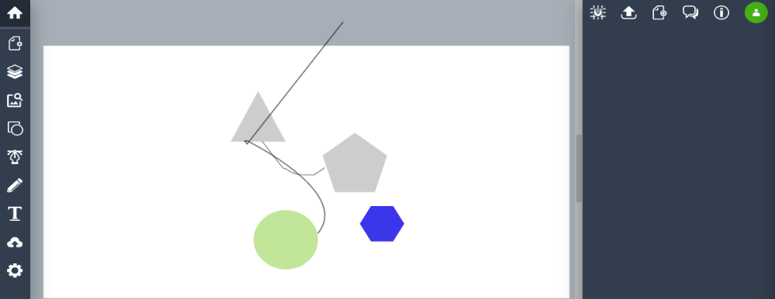
Multimedia (Graphics & Sound)
Vector Graphics
Vector graphics are:
made up of points, lines, curves and shapes that are based on mathematical formulas
can be designed using an application which uses a drawing canvas on the screen (eg: Vectr Software).

Slide 14
Multimedia (Graphics & Sound)
Vector Graphics Vs Bitmap images
Vector Graphic Images | Bitmap images
made up of geometric shapes which require definition/attributes | made up of tiny pixels of different colours
to alter/edit the design, it is necessary to change each of the geometric shapes | possible to alter/edit each of the pixels to change the design of the image
they do not require large file size since it is made up of simple geometric shapes | because of the use of pixels (which give very accurate designs), the file size is very large
because the number of geometric shapes is limited, vector graphics are not usually very realistic | since images are built up pixel by pixel, the final image is usually very realistic
file formats are usually .svg, .cgm, .odg | file formats are usually .jpeg, .bmp, .png

Slide 15
Multimedia (Graphics & Sound)
Vector Graphics Vs Bitmap images
Considerations when choosing a vector graphic or a bit-map image:
Does the image need to be resized? If so, a vector graphic could be the best option.
Does the image need to be drawn to scale? Again, a vector graphic is probably the best option.
Does the image need to look real? Usually bit-map images look more realistic than vector graphics.
Are there file restrictions? If so, it is important to consider whether vector graphic images can be used; if not, it's necessary to consider the image resolution of a bit-map image to ensure the file size is not too large

Slide 16
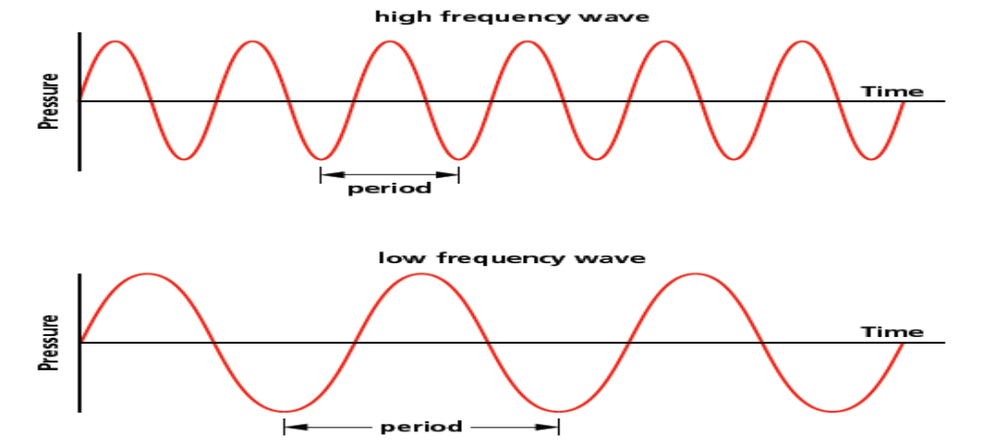
Multimedia (Graphics & Sound)
Sound Files
Characteristics of Sound:
Requires a medium to travel
has frequency and wavelength
amplitide determines the loudness of the sound

Slide 17
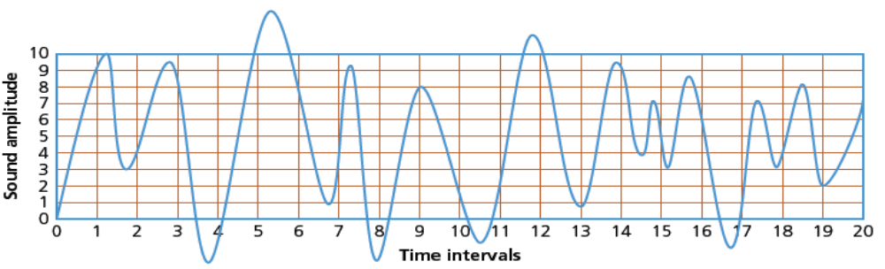
Multimedia (Graphics & Sound)
Encoding and Representation of Sound
Sound is an analogue value:
has to be digitised to store in computers
achieved through ADC (analogue to digital converter)
higher & lower frequencies outside of human hearing are removed
has to be sampled at a given time rate via ADC
The figure shows a sound wave with x-axis shows the time intervals whenvthe sound was sampled (0 to 20), and the y-axis shows the amplitude of thevsampled sound. Amplitude above 10 and below 0 are filtered out.

Slide 18
Multimedia (Graphics & Sound)
Definition of key terms used in encoding of sound
Sampling Resolution: the number of bits used to represent each sample. The higher the sample resolution, the better the quality of the sound recording
Sampling rate: the number of sound samples taken per second. The higher the sampling rate and/or sampling resolution, the greater the file size (eg: CDs use 16-bit sampling to give better sound quality)
How Sampling is done in a sound clip:
Amplitude of the sound wave is determined at set time intervals (the sampling rate).
This provides an approximate representation of the sound wave.
Sound wave is then encoded as a series of binary digits.

Slide 19
Multimedia (Graphics & Sound)
Definition of key terms used in encoding of sound
Sampling Resolution: the number of bits used to represent each sample. The higher the sample resolution, the better the quality of the sound recording
Sampling rate: the number of sound samples taken per second. The higher the sampling rate and/or sampling resolution, the greater the file size (eg: CDs use 16-bit sampling to give better sound quality)
How Sampling is done in a sound clip:
Amplitude of the sound wave is determined at set time intervals (the sampling rate).
This provides an approximate representation of the sound wave.
Sound wave is then encoded as a series of binary digits.

Slide 20
Multimedia (Graphics & Sound)
Pros and Cons of Using Higher Sampling Resolution for Recording
Pros (Advantages) | Cons (Disadvantages)
larger dynamic range | produces larger file size
better sound quality | takes longer to transmit/download sound files
less sound distortion | requires greater processing power

Slide 21
Multimedia (Graphics & Sound)
Class Activity for Unit 1.2 - Answer the following questions
1a) A software developer is using 16-colour bit-map images to develop a 2D game. State the number of bits required to encode data for one pixel of the image.
1b) One of the images is 16,384 pixels wide and 512 pixels high. The software developer decides to save it as a 256-colour bit-map image. Calculate the size of the image file.
2) What is sampling resolution in audio recording ? How does sampling resolution affect the accuracy of the recorded digitised sound ?
3) A software designer needs to incorporate images into her software to add realism. Explain what she needs to consider when deciding between using bit-map images and vector graphics in her software.

